Slide 1

Final project presentation: How popular will your video be on YouTube?
Berlin, 09.08.2022
Stephanie Fosso
& Weiling Peng
1 of 10

Slide 2
-1-
Intention of the project
-2-
Solutions based analysis
-3-
Challenges in the future
Agenda
2 of 10

Slide 3


A data-based solution project for – Miguel
Who is Miguel & Why he needs it?
WBS
Community Manager
Made 100+ videos
on YouTube to promote his business
Struggling on how to make popular videos
Owner of big holiday resort property in SA
Get lost on what videos to create
Do not know how audients feel after video posted
3 of 10

Slide 4
-1-
Intention of the project
-2-
data based solution
-3-
Challenges in the future
Agenda
4 of 10

Slide 5

Big data shows positioning channels on
–
Pets & Animals
💪
New positioning channel
Current channel
5 of 10

Slide 6
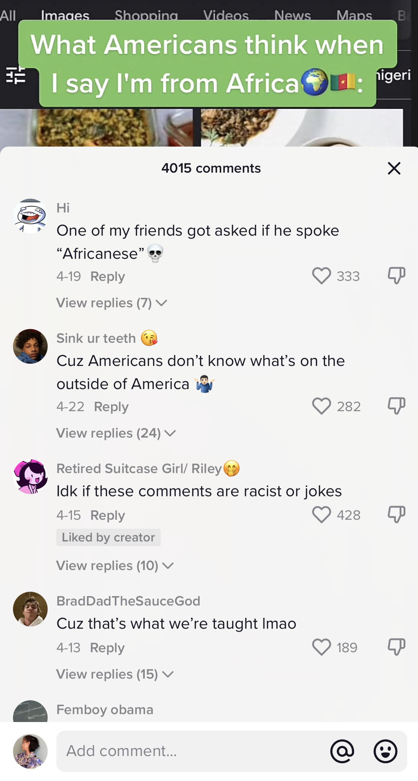
Straight way solution-
automatically filter comments
6 of 10

Slide 7
Straight way solution-
Premilitary predicting trending
7 of 10

Slide 8
-1-
Intention of the project
-2-
Solutions based analysis
-3-
Challenges in the future
Agenda
8 of 10

Slide 9
Straight way solution-
Let’s keep up-to-date
Algorithm and peoples life style may change
Always keep keep an eye on changes and adopt
Solution to suit into.
9 of 10

Slide 10
Thank you
&
happing Youtubing : )
10 of 10

